Slide 1

Can software engineer’s save human being ? SE 101
GAYAN SAMUDITHA
B.Eng. (Hon’s) Software Engineering
University of Westminster, UK.

Slide 2

How I started to save human being HealthCare

Slide 3



Intelligent Solution for Early Stage Prediction of
Cardiovascular Disease Using Machine Learning
and Multi-Agent Technology

Slide 4


Agenda
Background
Problem Domain
Aim
Objectives
Previous Works
High-Level Architecture Diagram
Methodology
Testing
Research Findings
Contributions
Conclusion

Slide 5

M.M.A. Gayan Samuditha
B.Eng. (Hon’s) Software Engineering
Supervised By
Achala Chathuranga Aponso
B.Eng. (Hon’s) Software Engineering, (University of Westminster, UK)
M.Sc. : Artificial Intelligence (University of Moratuwa, SL)
PhD : Multi-Agent Systems (Reading), (Monash University, AU)
AJNA -
Intelligent Solution for Early Stage Prediction of
Cardiovascular Disease Using Machine Learning
and Multi-Agent Technology
Machine Learning & Multi-Agent Systems

Slide 6


Background
Research Background

Slide 7
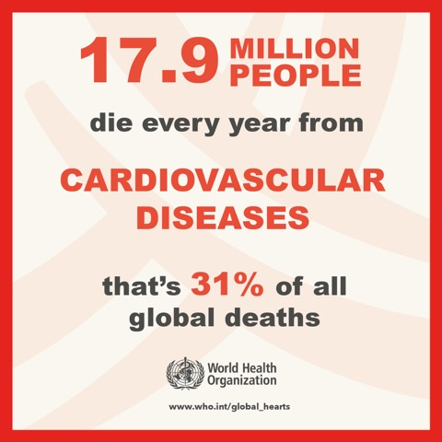
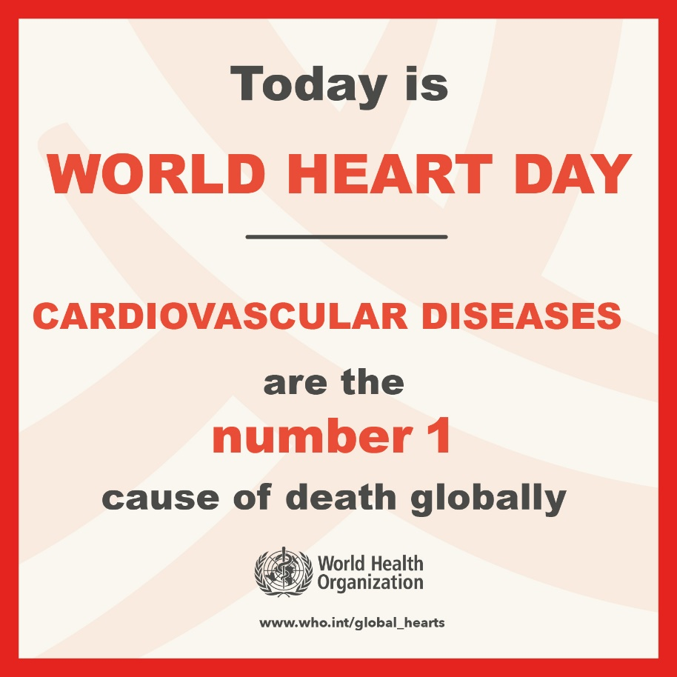

Background
Cardiovascular disease (CVD) is a class of diseases that involve the heart or blood vessels. CVD includes coronary artery diseases (CAD) such as angina and myocardial infarction (commonly known as a heart attack).
Other CVDs include stroke, heart failure, hypertensive heart disease, rheumatic heart disease, cardiomyopathy, heart arrhythmia, congenital heart disease, valvular heart disease, carditis, aortic aneurysms, peripheral artery disease, thromboembolic disease, and venous thrombosis.

Slide 8

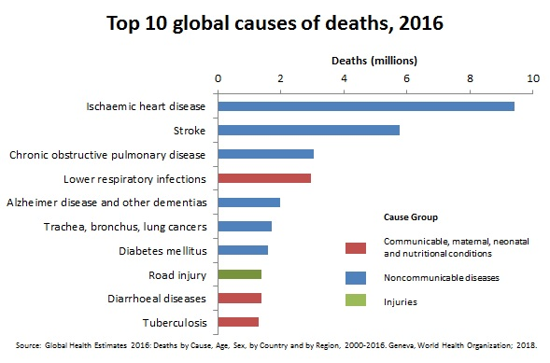
WHO reports on top 10 deathly diseases in 2018 survey facts.
“According to the World Health Organization (WHO) statistics shows cardiovascular disease represents, approximately death of 17.9 million of deaths rate in 2015 which represented 31% of all global deaths (WHO, 2018). It mostly highlight the developing countries in the world ”

Slide 9

Research Problem
General Research Problem
Specific Research Problem

Slide 10

General Research Problem Background
These clinical trials consist of different laboratory reports, scanning reports, ECG reports, physician’s symptom and examination diagnose reports, demographic factors, scan reports raw data etc. (Ambrosy et al., 2014, p1123–1133).
Clinical records as electronic health records (EH2R data). EHR data are the mostly all these clinical records that include vary of raw data on clinical trials (Kini et al., 2017, p628–640).
More explanation on EHR data, it provides huge quantity of data and technically it considers as big data.
There are millions of big data (Electronic health records) collecting by hospitals, clinical centers daily.
More consider about that technical processes, it will help to analyze these EHR data for do the same manual diagnosis can done by autonomously using machine learning based algorithms in minimum time (Denaxas et al., 2012, p1625–1638).

Slide 11
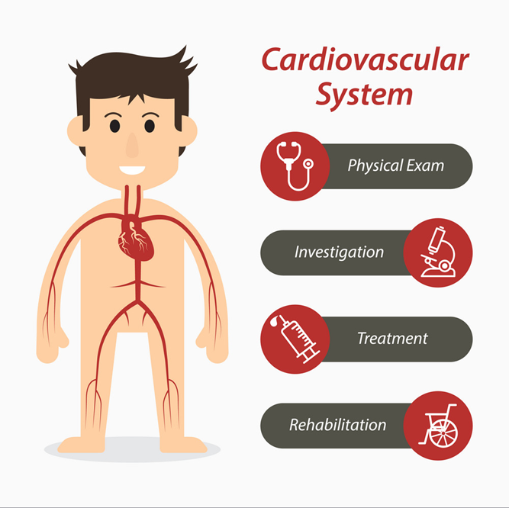
Traditional Clinical Diagnosis of Cardiovascular Disease
Clinical Diagnosis Stage 01:
Patient’s initial complaint stage, upon first appointment to the doctor,
Patient will explain the symptoms (problems) using their own words.
Symptom diagnosis processes.
Then physician compares between these answers from patient and diagnosis process, physician will write the diagnosis points on patient’s clinical description.
Clinical Stage Conclusion: If it is not completely obvious to the doctor, the disease is not yet diagnosed.
Clinical Diagnosis Stage 02:
After the first stage of diagnosis, then physicians will check patient again.
More information about the disease.
Checking how far the cardiac symptoms were developed and the patient’s condition. Questioning the patient with current diagnosis status
Patients will move to the next clinical stage to examine the patient by cardiovascular specialist.
Clinical Stage Conclusion: The new diagnosis has been pointed down to a few diseases and for further specific diagnosis, physicians will move the patients to cardiovascular specialist for further disease diagnosis

Slide 12

Specific Research Problem Overview
Most traditional methods that developed for disease prediction approaches have been used statistical regression-based models.
Although useful and vigorous of these traditional statistical models are limited to using a minor number of predictors which apply for the same way on everyone and eventually throughout their range (G et al., 2013).
Not only that, the complexity of the diagnosis process and human interconnect manual processes are time consuming and inefficient
(Singh et al., 2018, p121–124).

Slide 13
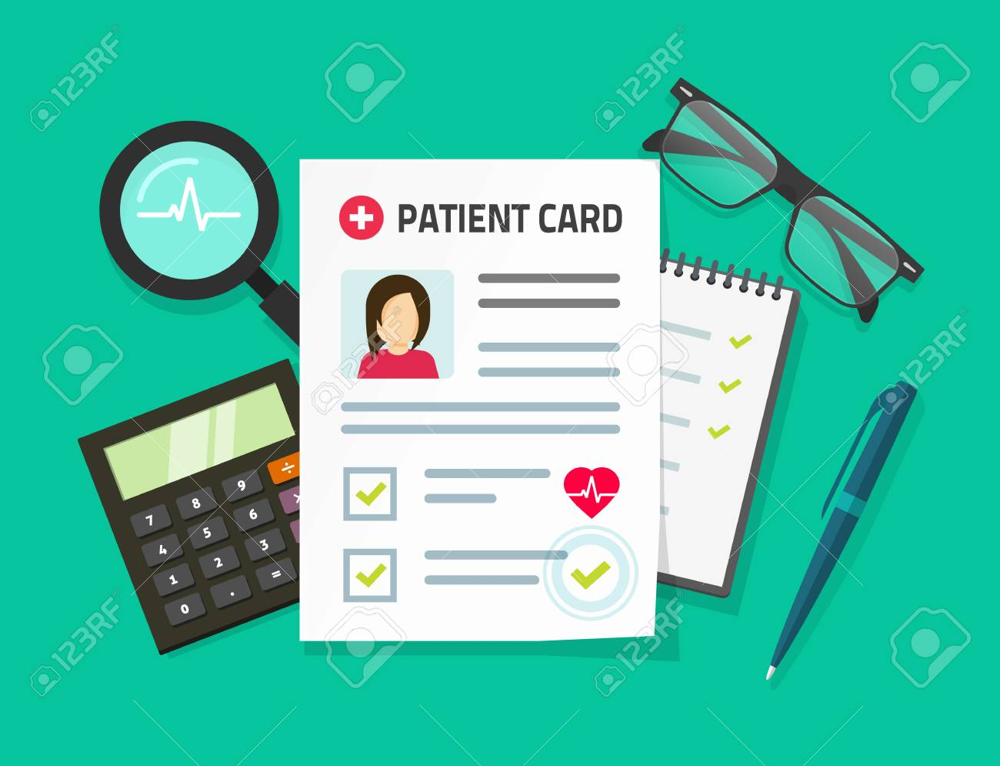
Specific Problem Statement
“The problem of the physician has long needed to identify, analyze, quantify and clarify the relationships among feature variables (Clinical trials) to advance progress for patient care. Does it can practically do in manually way for early-stage prediction of Cardiovascular Diseases for all patients individually? How to improves these processes using high-quality diagnosis processes with machine learning based artificial intelligence techniques to solve these problems accurately.”

Slide 14

Aim of the Research

Slide 15


The Aim of the Research
“This research project aims to design, develop and evaluate an Artificial Intelligence-based autonomous prediction engine to assist physicians (Cardiothoracic Surgeons and Cardiologists) at the point of patient care; interact with the system to help diagnosis, analysis and early stage prediction of Cardiovascular Diseases of using patient’s clinical history data.”

Slide 16

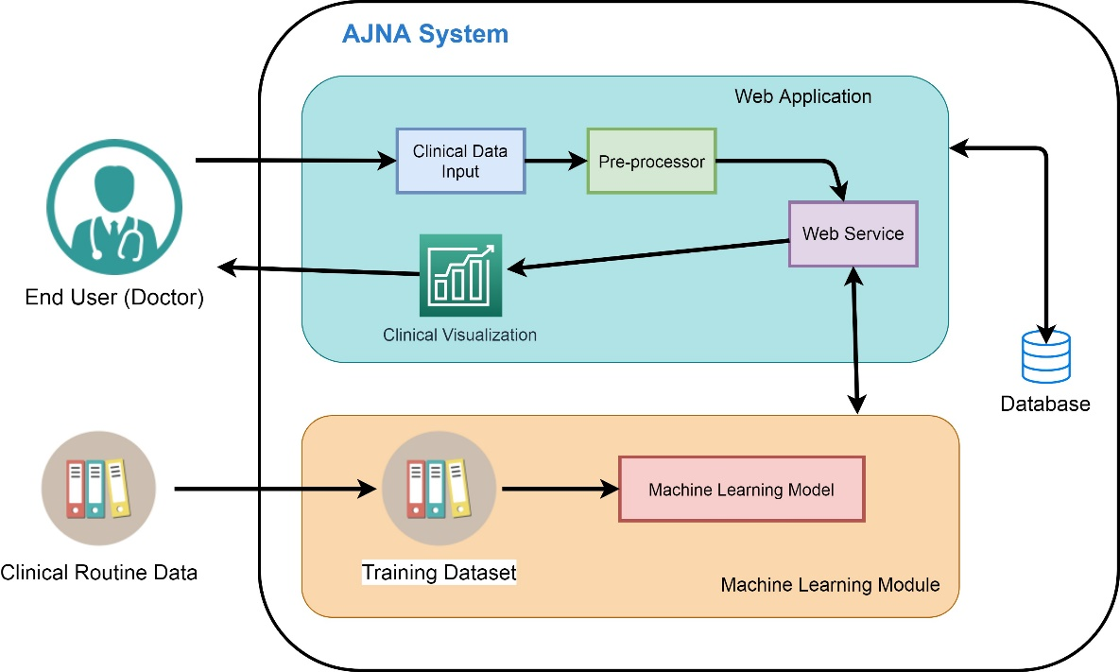
Proposed Solution

Slide 17

Objectives of the Research
Research Objectives – Cardiovascular disease diagnose modelling
Objective
To identify all diverse pathways to end-stage Cardiovascular Disease
Analyze the availability of existing computer aided cardiac models
Implement Machine Learning based AI prediction engine
Apply the diagnosis models to prediction engine and analyze
Evaluate the prediction engine using patient’s clinical history
Technical Objectives – Technical Perspectives and Design Model Architecture
Objective
To identify the specific risk factors on Cardiovascular
Analyze the risk factors
Survey on best machine learning algorithms
Analyze the model for selecting the best machine learning algorithms
Analyze the ML decision model
Implement the model using machine learning techniques and data mining concepts
Evaluate the prediction engine

Slide 18


Research Level Cardiovascular Prediction Tools: Used for research level analysis of cardiovascular risk predictions. Most of these tools developed by research-based institutions for research level purposes. Deployed to some healthcare authorities to test the tool accuracy levels and overcome. Most of the research level prediction tools are limited to their already associated healthcare centers and hospitals etc. These types of tools did not deploy for production level. * Research Level Tools: QRISK, QRISK2, QRISK3, SCORE etc.
Production Level Cardiovascular Prediction Tools: There are limited number of tools were introduced for production level cardiovascular risk prediction. Introduced by IBM Watson research center, California, USA. Most of the tools were used by hospitals, medical care centers and other healthcare facilities. * Production Level Tools: IBM Watson Care Manager, Merge Cardio etc.

Slide 19

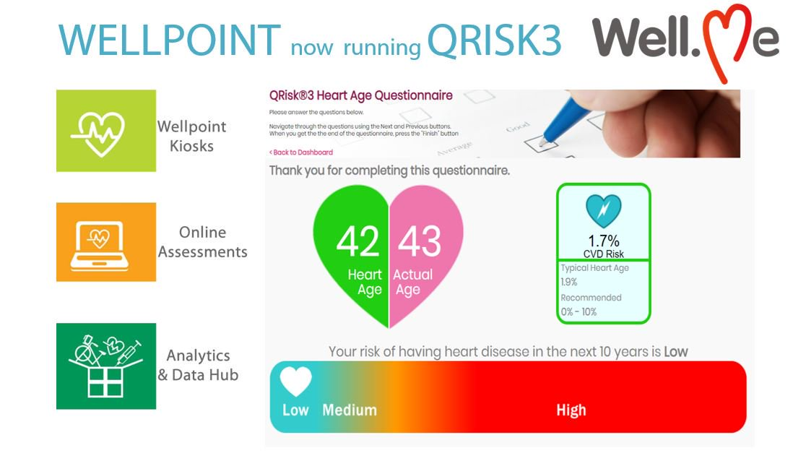
Research Level Cardiovascular Prediction Tools

Slide 20
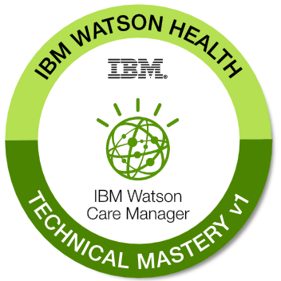
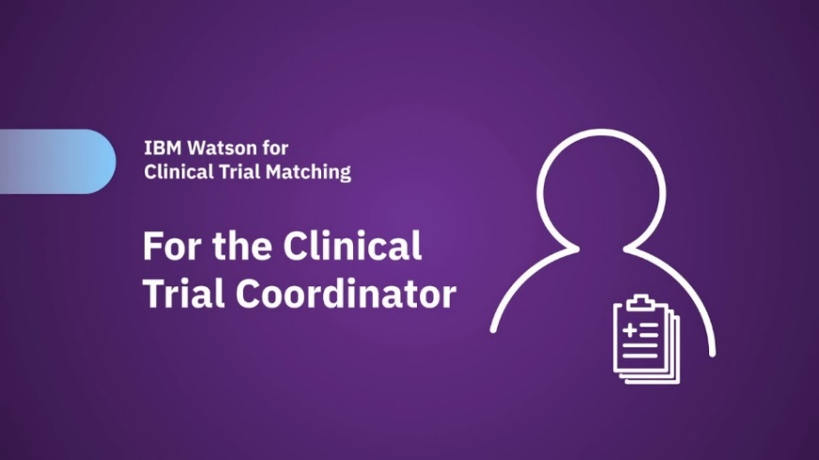
Research Level Cardiovascular
Prediction Tools
IBM Watson Care Manager ( Watson Care Manager, 2019)
IBM Watson Care Manager is cloud based healthcare management system help the healthcare organizations to focus on patient care. Care teams can capture the clinical details both unstructured and structured information, selected programs and create individualized care plans for patients. These care plans can be adjusted to address changing biological, social, physiological and functional needs.
Features
Care management workflows Health Summary Review Third-party system integration
IBM Watson Oncology Clinical Trail Matching (2017)
Watson oncology clinical trial matching platform provide clinicians to more easily and quickly find the patients clinical trials. Then it helps to coordinate clinical trials,
Features
Analyzes structured and unstructured patient’s data
Support proactive patient identification
Identifies a list of relevant trial options

Slide 21

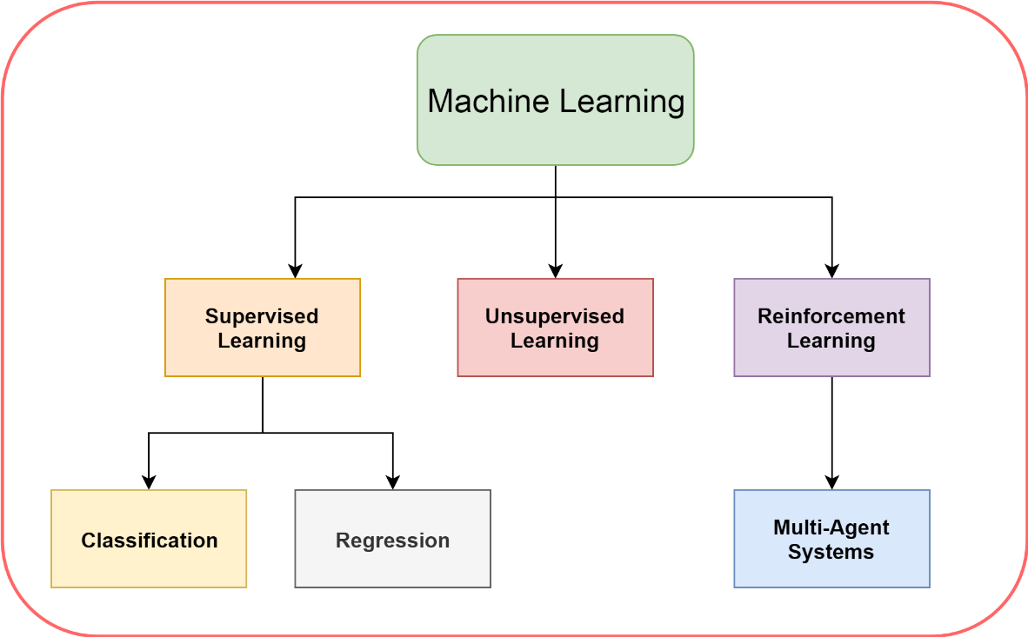
Key Findings – Literature Review
Identify the Cardiovascular Clinical Processes.
Research Level Existing Systems vs Production Level Existing Systems.
Electronic Health Records (Clinical Data).
New concepts of Machine Learning models and Algorithmic Analysis.
Binary Classification Approaches :
Supervised Learning – Classification (TensorFlow and Kera’s)
Reinforcement Learning Concepts
Multi-Agent Technologies in Cardiovascular Disease Management
Multi-Agent Learning in Prediction Environment (Reinforcement Learning Environment)

Slide 22

System Requirement Specification
Domain Expert Surveys
Cardiology Domain Expert Survey
Machine Learning & Multi-Agent Systems Domain Expert Survey
Formal Interviews with Domain Experts
Cardiology – Cardiothoracic Domain Experts (Physicians)
Cardiovascular Domain Expert (Specialize in Cardiovascular Medical Research)
Machine Learning – Domain Experts
Multi-Agent Systems – Domain Experts

Slide 23

SLEP Analysis
Social Analysis: - Impacts on the individual’s patient’s health profile, when unwanted parties notice the proposed health status. Unexpected struggles/disputes. | Ethical Analysis: - Patients clinical history and reports contravention (Privacy Breaches) Overhearing – Patients health status
Legal Analysis: - Patients Clinical Reports infraction. Computer Misuse Act Violation | Professional Analysis: - Health Data code of conduct comply to the published guidelines, conducts and policies of the institution in Sri Lanka, when specify the research protocol guidelines.
Technological Analysis: - Technological developments specific for hospitals and healthcare manufactures could have a changeable range of effects on system overall performance | Economic Factor Analysis: - Considering about the product cost deliverable when it comes to production level.

Slide 24
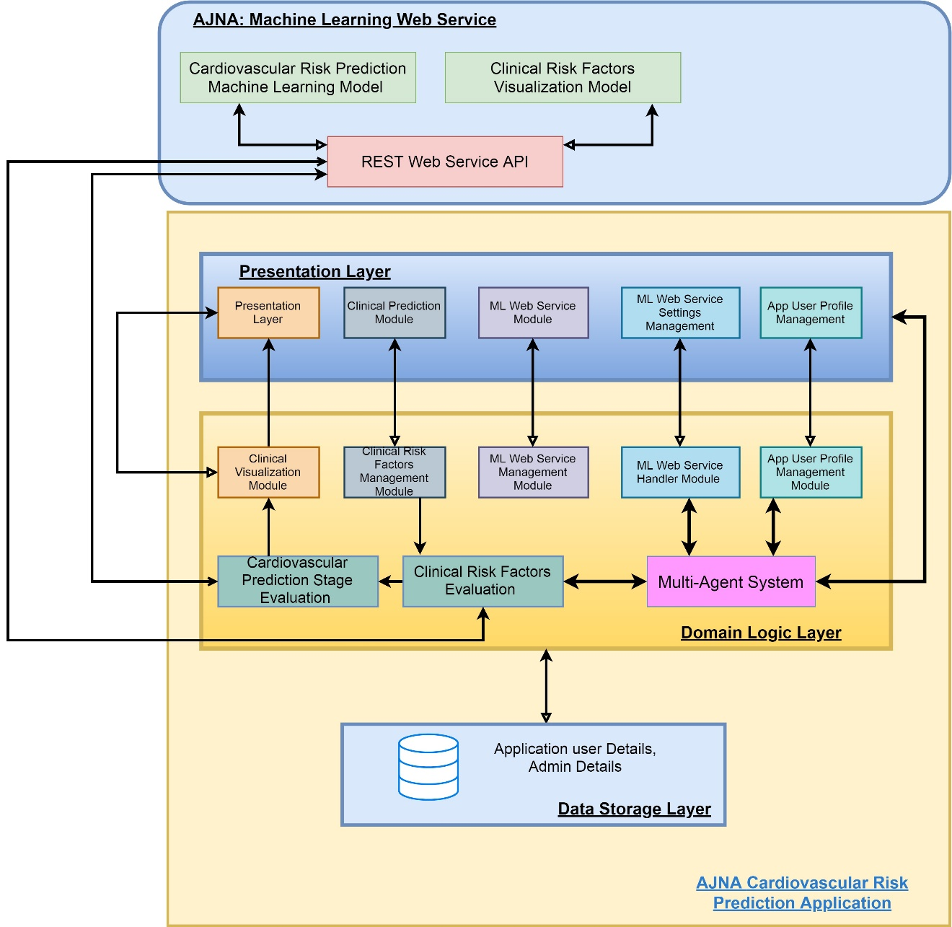

High-Level Architecture

Slide 25
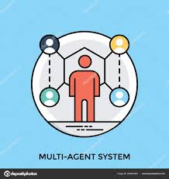
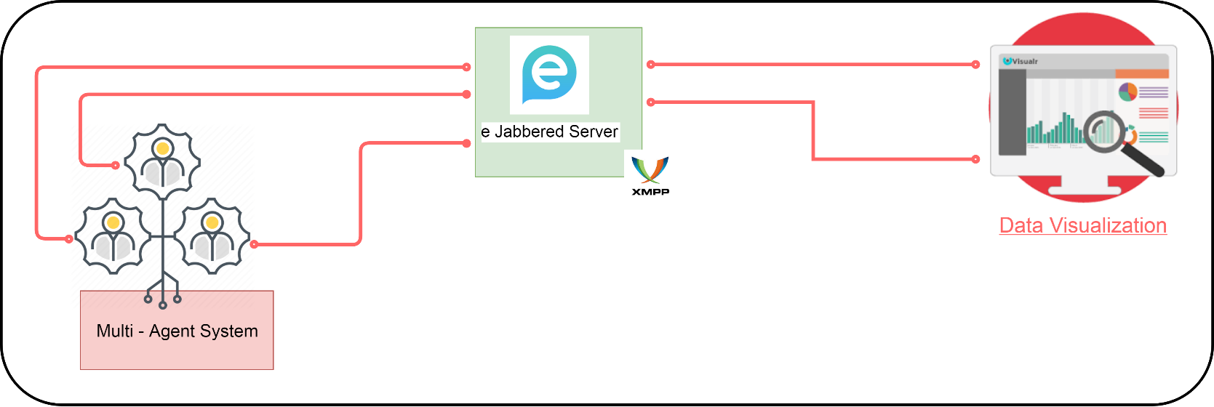
Multi-Agent Communication Architecture
How agent-communication working?
Intelligent Agents of Multi-Agent Systems
E Jabbered Server – XMPP Server Connections with Visualizations
Data visualizations with agent systems

Slide 26

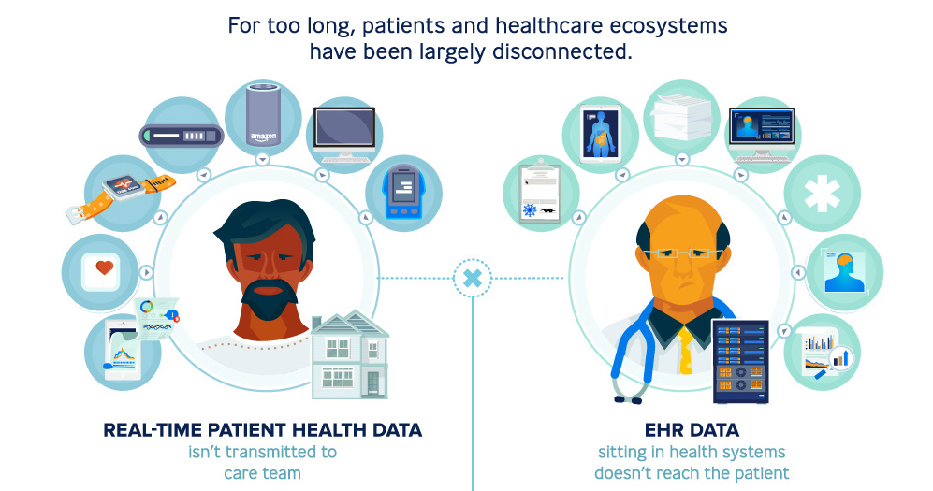
Dr. Zahra Alizadeh Sani
Associate Professor of Cardiology / Cardiovascular imaging Specialist
Cardiovascular Imaging Department,
Rajaei Cardiovascular Medical & Research Center,
Iran University, Tehran, Iran.

Slide 27

Intelligent Solution for Early Stage Prediction of
Cardiovascular Disease Using Machine Learning
and Multi-Agent Technology

Slide 28
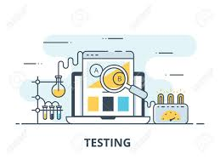
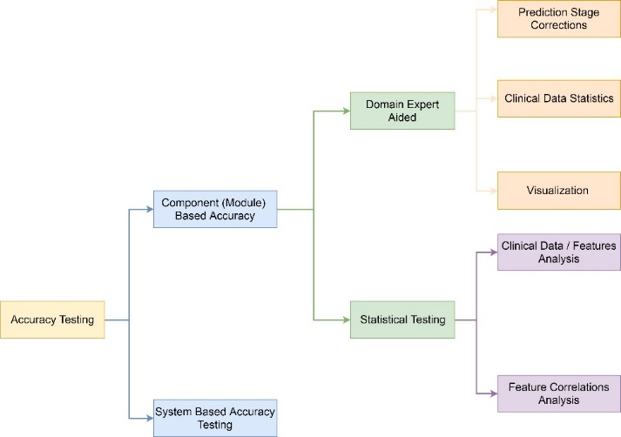
Testing Process – AJNA Platform

Slide 29

Testing – Cardiovascular Prediction Module
Measure | Value
Accuracy | 73%
F1 Score | 0.844490
Precision | 0.730838
Recall | 0.953478
True Positives (TP)
Predicted value = Positive
Actual value = Positive
True Negatives (TN)
Predicted value = Negative
Actual value = Negative
False Positives (FP)
Predicted value = Positive
Actual value = Negative
Summarization of Accuracy Report
False Negatives (FN)
Predicted value = Negative
Actual value = Positive
 | Predicted (NO) | Predicted (YES)
Actual (NO) | TN=281 | FP=21
Actual (YES) | FN=7 | TP=813
Confusion Matrix

Slide 30

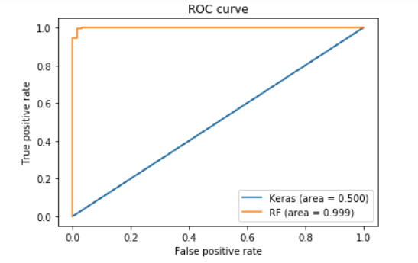
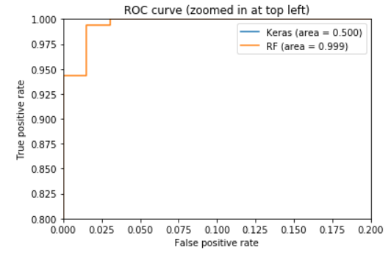
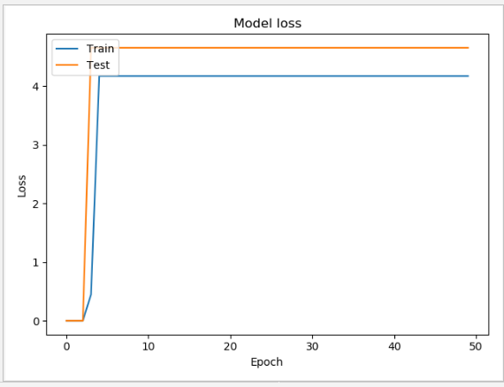
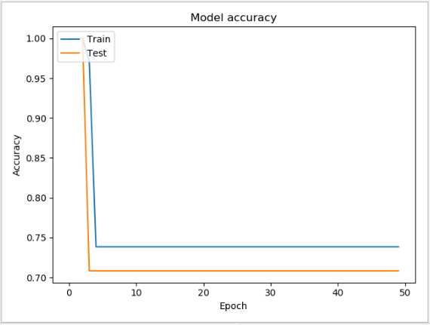
Cardiovascular Prediction Module – Accuracy Testing
ROC Curve
ROC Curve (Top left)
Model Accuracy Training Graph
Model Training Loss Graph

Slide 31


AJNA – Platform Benchmarking
Tool Name | Feature Overview
IBM Watson – Oncology (IBM Watson for Oncology, 2017) | “Helps physicians quickly identify key information on a patients’ medical record, surface relevant evidence and explore treatment options.”
Watson Clinical Reviewer (IBM Watson Imaging Clinical Review, 2018) | “This tool is a retrospective AI-enabled data review tool that helps support a reliable patient record in order to drive accurate, timely and coordinated care decisions.”
IBM Watson - Care Manager (Watson Care Manager, 2019) | “Handles the patient’s clinical records and automate care management workflows.”
Watson – MERGE CARDIO (Merge Cardio, 2019) | “Merge Cardio allows you to access and manage your patients’ digital integrated cardiovascular records from a centralized, web-enabled system, anywhere, any time.”
Watson – MERGE HEMO (Merge Hemo, 2018) | “Merge Hemo automates your cath lab process – including data collection, waveform analysis, inventory control and procedural reporting – into a comprehensive digital patient record.”

Slide 32


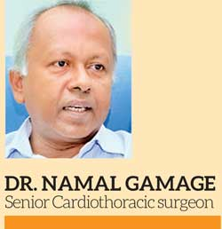



Domain Expert Evaluation
Dr. Kushan Gunarawardhana
Research Scientists – Cardiovascular Medicine
Yale Cardiovascular Research Center
PhD – Specialize in Bioinformatics and Molecular Biology,
Dr. Namal Gamage
Cardiothoracic Surgeon
Cardiothoracic Unit – Teaching Hospital Karapitya, Galle
Dr. Mano Mathew
Associate Professor, Head of the Bioinformatics, EFREI, Paris
PhD – Specialize in Bioinformatics
Aix-Marseille University, France
Dr. Saad Khan
Senior Software Engineer - HIRETUAL
PhD – Specialize in Microservices, Serverless Computing, Machine Learning and Multi-agent Systems
University of Central Florida
Dr. Isuru Daulagala
Software Engineer – Nvidia Corporation, California
Specialize in Machine Learning
B.Sc. - Drexel University, USA
PhD – Stanford University, USA

Slide 33

Contributions of the Study
Technical Contribution
1. New Architecture – Binary Classification Keras Neural Network Model
2. Accuracy Improvement – New Hybrid Model Implementation
3. Visualization based user interaction system
4. Knowledge Based System – Multi-Agent Systems
Medical Contribution
A portable disease diagnosis tool for doctors to identify risk of patients
Identify Cardiovascular Disease in its early stages
Visualization Components based clinical data analysis

Slide 34

Limitation and Future Recommendations
Limitation 01 | Limitation on scope of the cardiovascular risk factors used in platform
The risk factors scope describes the scope of area that cardiovascular prediction system covers. In the platform fifty-nine risk factors were used for the prediction process and cardiovascular risk assessment scope can be expand by adding new risk factor to the system.
Limitation 02 | Restrictions on visualization of clinical trials
The platform output cardiovascular disease prediction stage assessment for the physician and it only include the text and charts. In future, the platform can be enhanced to provide image classification for further analysis of the cardiovascular disease prediction.
Limitation 03 | Platform only restrict for the key success factors of a cardiovascular prediction platform
The platform majorly focused on performance key factors and accuracy level of the system. Furthermore, platform can be expanded to improve the new key factors and address other key factors such as scalability and performance.
Limitation

Slide 35
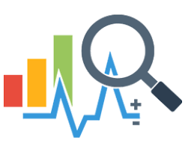
Future Enhancements
Enhancement 01 | Use more risk variables for analysis the diagnosis in wide range.
By adding more risk variables will increase the diagnosis accuracy level and scope of the diagnosis.
Priority | High Level Priority
Enhancement 02 | Provide access to more web service models
Expand the platform to support more machine learning web service modules which use for predictions. This will help to enhance the system performance and scalability of the platform.
Priority | High Level Priority
Enhancement 03 | Improve the clinical diagnosis dashboard
Expand the clinical diagnosis dashboard with new UI components
Priority | Low Level Priority
Enhancement 04 | Add new image processing components for analyze the scan data
Add image processing components to system for analyze the scan image data for diagnose the cardiovascular diseases.
Priority | High Priority

Slide 36
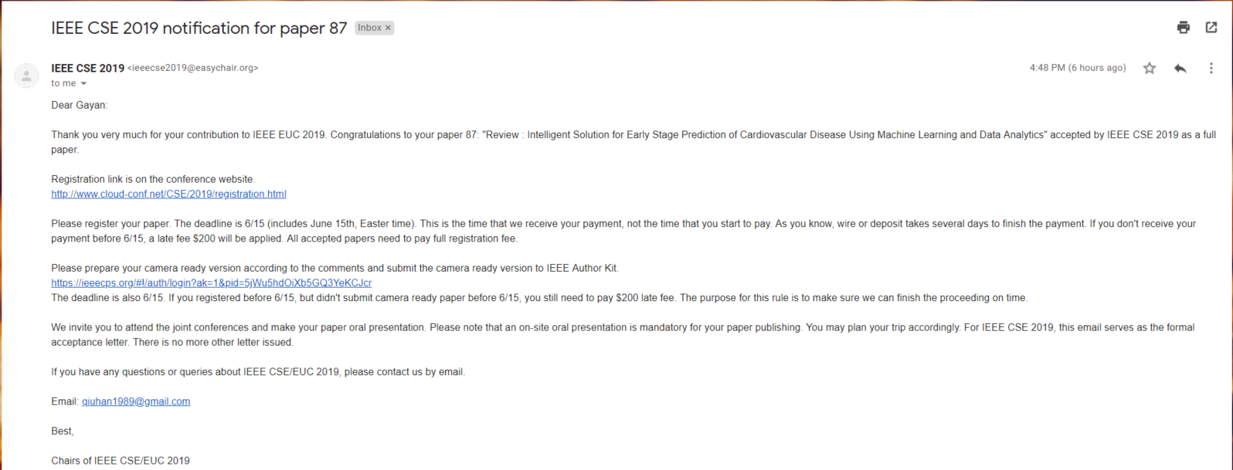






2019 IEEE International Conference on Computational Science and Engineering (CSE) and IEEE International Conference on Embedded and Ubiquitous Computing (EUC)

Slide 37
Thank You
Questions and Answers

